Slide 1

How to hack wifi using wifite
By: Abdul Hameed

Slide 2
Wifite:
Wifite is a tool to audit WEP or WPA encrypted wireless networks. It uses aircrack-ng, pyrit, reaver, tshark tools to perform the audit. This tool is customizable to be automated with only a few arguments and can be trusted to run without supervision.

Slide 3
Commands that we will be using:
Wifite --wep
Wifite --wpa
Wifite --wps

Slide 4
Yes, these are the only commands you need to know!

Slide 5
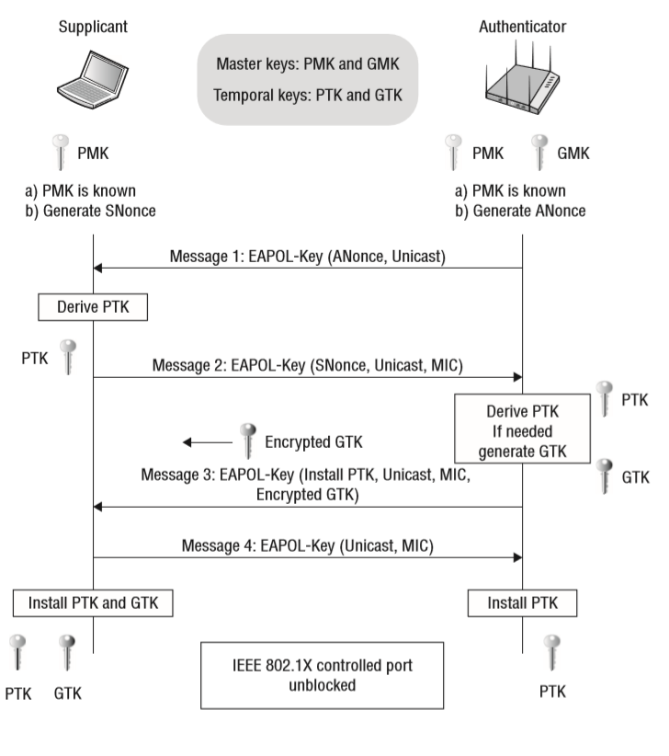
We will be hacking wpa/wpa2psk encrypted wifi
What is 4-way Handshake:
The 4-way handshake is the process of exchanging 4 messages between an access point (authenticator) and the client device (supplicant) to generate some encryption keys which can be used to encrypt actual data sent over Wireless medium. These keys which are generated through 4-way handshake are generated by some source key material

Slide 6
How I hacked my neighbors wifi
Gathered information about the wifi.
Got the default password of a few same isp routers.
Compared the keys and narrowed down the password.
Finally hacked it.

Slide 7
Live demo!

Slide 8
For More on 4-way handshake visit:
https://www.wifi-professionals.com/2019/01/4-way-handshake

